Slide 1

FINAL MASTER’S THESIS PRESENTATION
Empowering Sign Language Communication: Image Based Recognition, Domain Specific Language Modeling, And Facilitating Rare Word Expression
Supervisor: Dr. Julie Weeds
Second Marker : Prof. Stephan Huber
Author: Swati Gupta – 260830
Date: September 11, 2023

Slide 2







Topics Covered In Dissertation Report
Abstract
Introduction
Related Work
Methodology
Result and Discussion
Conclusion and
Further Work
References

Slide 3

Introduction
Around 430 million human beings worldwide suffer from a disabling hearing insufficiency, and the number is anticipated to increase up to over 700 million by the year 2050, according to the World Health Organization. This indicates that roughly 5% of people worldwide have hearing impairment (Deafness and Hearing Loss, n.d.).
People who have hearing impairments or are not able to speak use Sign Language to communicate visually using gestures, facial expressions, and body language. Sign Languages (SL) convey meaning through physical movements or a visual manner.
There are around 135 official sign languages spoken worldwide, each with its own vocabulary and gestures, showcasing the diverse range of sign languages used in different parts of the world (How Many American Sign Language Signs Are There? | Homework.Study.Com, n.d.).
Sign language detection is important because it promotes accessibility, inclusion, and equality for Deaf and hard of hearing individuals. It enhances their ability to communicate effectively in various contexts, ultimately improving their quality of life and participation in society.
British Sign Language consists of approximately 1,800 signs represented through pictures and diagrams(What Is British Sign Language? - Information about BSL, n.d.), with each sign accompanied by definitions, explanations, and usage. In contrast, the English language comprises over a million words in total, with approximately 170,000 words in current use(How Many Words Are in the English Language? | English Live, n.d.).

Slide 4
Challenges

Slide 5

Objectives
Establish a domain-specific knowledge base for the language model, enabling efficient word detection. This approach can be expanded in the future to incorporate contextual information and facilitate sentence construction for domain-specific or language-specific modeling.
Develop a highly accurate model for detecting Sign Language gestures, aiming for an accuracy of over 90 percent. The accuracy of predicting a word is heavily dependent on the quality of this intermediate output.
Investigate the potential impact of Bi-LSTM model on improving the accuracy of complete word prediction and correction occurred by CNN model.
Develop a program to capture real-time images from the laptop camera, serving as test samples, to be able to evaluate the practical importance of sign language detection. These images will then be leveraged to assess the effectiveness of the developed image recognition model.
Evaluate the effectiveness of using the Bi-LSTM model to refine the predictions made by the image processing component for individual images. The Bi-LSTM model will have access only to the final prediction of the image processing module, which will be in text format.
Preprocess MeDAL dataset and assess the effectiveness of using LSTM and BiLSTM model for next word prediction.
Ultimately, determine the best approach by comparing the time required for each method. This involves evaluating the efficiency of manual signing for individual letters, using the CNN-based approach for sequential character signing, and implementing the hybrid approach that combines both CNN and Bi-LSTM techniques.

Slide 6
Background

Slide 7
Related Work
Sign Recognition From CNN
This research predominantly focuses on a specific aspect within the Sign Language domain through the creation of a hybrid system. It's worth noting that there is limited prior research directly aligned with this unique approach. Consequently, we will examine existing studies that pertain to the developed models, specifically in the context of their roles within the comprehensive pipeline approach.
Dong et al. (2015): Introduced a contemporary ASL alphabet recognition approach using Microsoft's Kinect, achieving 90% accuracy for 24 static ASL alphabet signs.
Rao et al. (2018): Introduced a CNN-based approach for Indian Sign Language gesture recognition with an impressive 92.88% accuracy.
Bheda and Radpour (n.d.): Presented a technique for classifying ASL alphanumeric characters, achieving recognition rates of 67% for alphabet characters and 82.5% for ASL digits using self-generated and MU HandImages ASL datasets.
Unique Spelling Correction Approach
Errors arise from the CNN model misidentifying ASL alphabet letters, not English words, rendering traditional error correction methods ineffective. To tackle this challenge, we created a dataset mapping errors to correct spellings, which were derived from the CNN model's mistakes. We further analyzed the confusion matrix to pinpoint speciic error patterns, all with the ultimate goal of enhancing ASL alphabet detection accuracy using our CNN approach.
Next Word Prediction
To delve into next-word prediction, we reviewed the article titled "Next Word Prediction Model" by Aman Kharwal (n.d.), which employs tokenization and LSTM models, achieving an accuracy of approximately 0.56 through the analysis of word patterns.

Slide 8
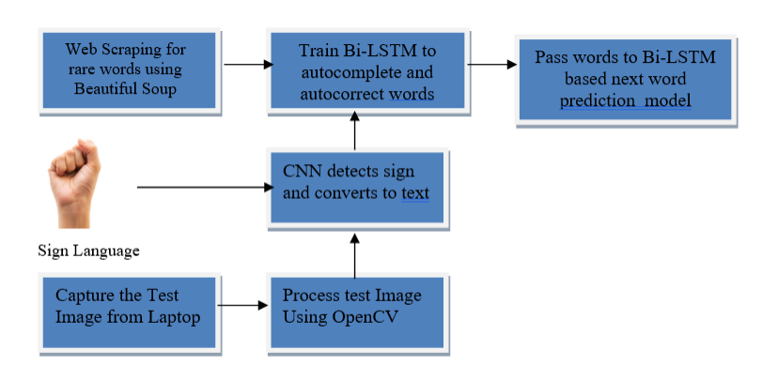
Methodology
Experimental Environment
Proposed Approach
Web Scraping Data for Collecting Biology Terms
Model Architecture of CNN for American Sign Language Detection
Data Augmentation for CNN
Hyperparameter Tuning with Bayesian Optimization for CNN Architecture
Final Architecture of CNN Model
Model Architecture of Auto Correcting and Auto Completing Biology Words
Data Preprocessing for Auto Correcting and Auto Completing Biology Words Model
Hyperparameter Tuning with Grid Search for Auto Correcting and Auto Completing Biology Words Model
Final Architecture of Auto Correcting and Auto Completing Biology Words
Model Architecture for Next Word Prediction
Data Preprocessing for Next Word Prediction
Final Model Architecture for Next Word Prediction
Hand Image Collection Program using OpenCV and Hand Tracking
Performance Measures
Recall
Precision
F1 Score
Confusion Metrics
Block Diagram for rare biology terms communication in American Sign Language

Slide 9
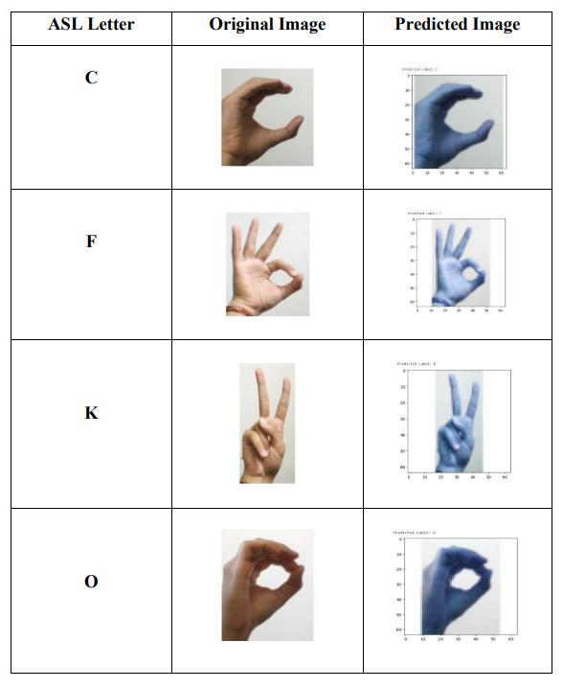
Result and Discussion
Result Discussion of ASL Model
We conducted hyperparameter tuning on our CNN for ASL detection, utilizing Bayesian Optimization. Following training with the fine-tuned hyperparameters, we attained an outstanding validation accuracy score of 0.996. The model's training data comprised the American Sign Language Dataset for Alphabets.
Result Discussion of Bi-LSTM Based Auto Correction and
AutoComplete Model
The Bi-LSTM model for Auto Correction and Autocompletion underwent hyperparameter tuning through Grid Search Optimization. Following training with the optimized hyperparameters, we obtained a noteworthy validation accuracy score of 0.93. This model was trained using data scraped from various biology-related websites
Result Discussion of LSTM Based Next Word prediction Model
When working with an LSTM-based next word prediction model, we conducted training using the MeDAL dataset. Our model achieved impressively high probabilities for next word predictions, reaching up to 0.73
Table showing Real Time Images captured from Laptop Camera and the detection result after passing through CNN

Slide 10
Conclusion and Future Work
Achieved Research Goals
Successfully developed a comprehensive system for recognizing and communicating uncommon biology-related words in American Sign Language (ASL).
Proposed an innovative approach that streamlines and accelerates sign language communication.
Future Work
Enhancing Sign Recognition Models
Improve the CNN model by creating separate models for specific letter recognition (e.g., "V" and "W") and implementing a voting mechanism for more accurate alphabet detection.
Continuous Vocabulary Expansion
Continuously analyze errors made by the CNN model and develop corrections for misspelled words. These corrections can be used to retrain the Bi-LSTM model, expanding its vocabulary.
Refining Auto-Completion
Address issues arising from character-based training data for auto-completion, particularly in cases where similar spellings can lead to confusion. Develop strategies to mitigate such challenges.
Adaptation to Different Sign Languages
Extend the architecture to accommodate various sign languages, such as British Sign Language and Indian Sign Language, to make the system accessible to a wider user base.

Slide 11
Thank You
I welcome questions from the panel.

